Slide 1

Substitution Method for Logarithmic Growth
GUIDED BY
Dr.K.RAJAGOPAL
SIMATS Engineering
STUDENT
SRIMATHI.H(192524403)
Dept of AIDS
SIMATS Engineering

Slide 2
INTRODUCTION
The Substitution Method is used to solve and prove recurrence relations.
It assumes a solution and verifies it using mathematical induction.
It is widely used in the Design and Analysis of Algorithms (DAA).
It helps determine the time complexity of recursive algorithms.
It is commonly applied to divide-and-conquer algorithms.
For logarithmic growth, the recurrence relation is T(n) = T(n/2) + 1.
Since the problem size is halved in each step, the time complexity is O(log n).

Slide 3
PROBLEM STATEMENT
Analyze the recurrence relation T(n) = T(n/2) + 1.
Apply the Substitution Method to solve the recurrence.
Assume a solution and verify it using mathematical induction.
Simplify the recurrence relation step by step.
Prove that the assumed solution satisfies the recurrence.
Determine the time complexity as O(log n).

Slide 4
ALGORITHM
Start with the recurrence relation T(n) = T(n/2) + 1.
Assume the solution T(n) ≤ c log₂ n, where c is a positive constant.
Substitute the assumed solution into the recurrence relation.
Simplify the expression using logarithmic properties.
Verify that the inequality holds for a suitable value of c.
Conclude that the recurrence relation has a time complexity of O(log n).

Slide 5
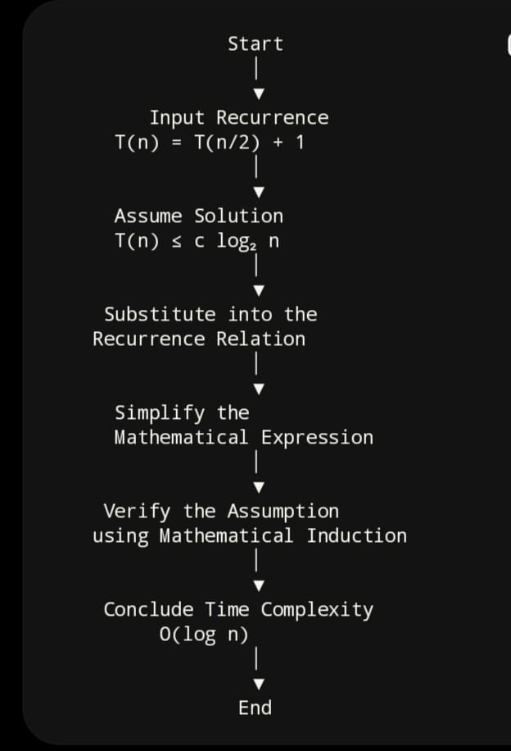
ARCHITECTURE DIAGRAM

Slide 6
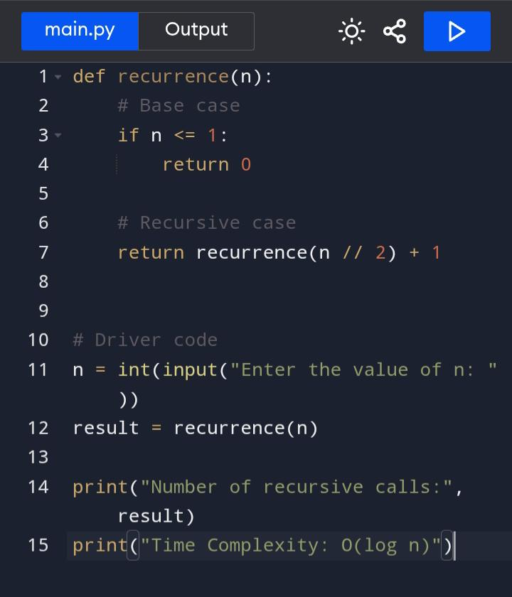
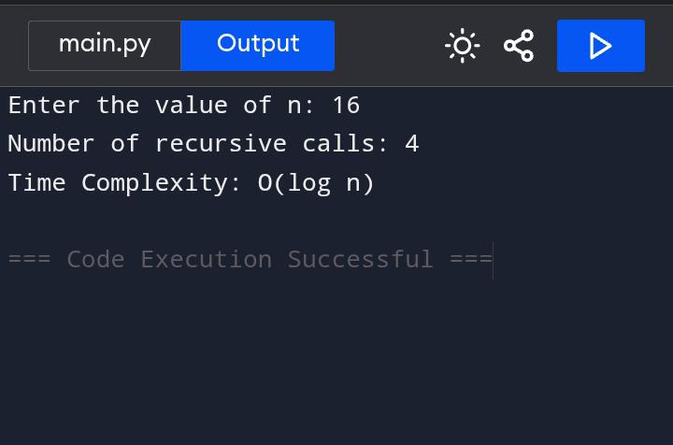
IMPLEMENTATION

Slide 7
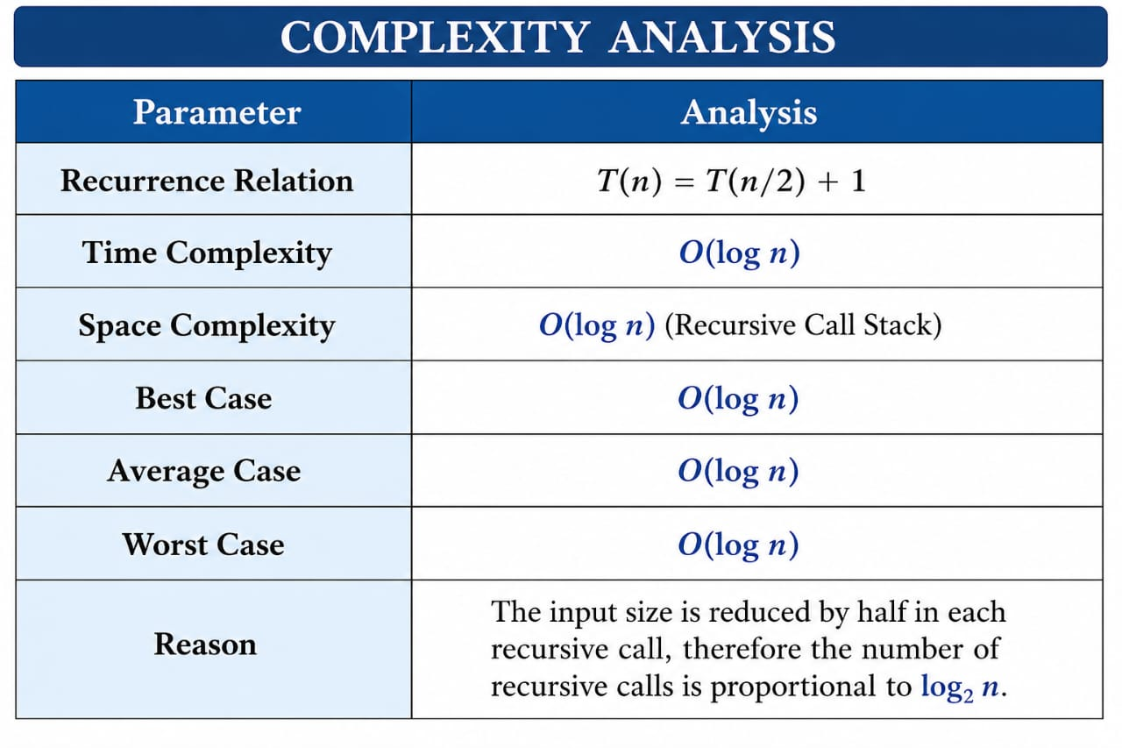

Slide 8
CONCLUSION
The Substitution Method is an effective technique for proving the time complexity of recurrence relations.
For the recurrence T(n) = T(n/2) + 1, the problem size is reduced by half at each recursive step.
The recurrence is proven to have O(log n) time complexity using mathematical induction.
This method is widely used to analyze divide-and-conquer algorithms such as Binary Search.

Slide 9
REFERENCE
Thomas H. Cormen, Charles E. Leiserson, Ronald L. Rivest, and Clifford Stein, Introduction to Algorithms, 4th Edition, MIT Press, 2022.
Ellis Horowitz, Sartaj Sahni, and Sanguthevar Rajasekaran, Fundamentals of Computer Algorithms, 2nd Edition, Universities Press.
Alfred V. Aho, John E. Hopcroft, and Jeffrey D. Ullman, The Design and Analysis of Computer Algorithms, Addison-Wesley.
Donald E. Knuth, The Art of Computer Programming, Volume 1: Fundamental Algorithms, Addison-Wesley.

Slide 10
THANK YOU

